Slide 1
Pandit Jawaharlal Nehru college of Agriculture and Research Institute, Karaikal - 609603
Report on strengthening of infrastructure facilities of the
Department of Horticulture under DBT- Star College Scheme
Advisory Committee Meeting on 09.08.2023

Slide 2
COURSES OFFERED BY THE DEPARTMENT OF HORTICULTURE
B.Sc. (Hons.) Agriculture B.Sc. (Hons.) Horticulture M.Sc. (Horticulture) in Vegetable Science Ph.D (Horticulture) in Vegetable Science (To be offered)

Slide 3
B. Equipment’s procured – non recurring CONTIGENCY
Sl.No | Name of the equipment | Unit cost | Number of unit | Actual Cost (factual fsigure, not in lakh
1. | Work table with stainless steel top | 99,710 | 1 | 99,710
2. | Strapping machine for cartons | 2,940 | 1 | 2,940
3. | Handy PH & EC meter | 14,700 | 1 | 14,700
4. | Fruit and vegetable processing accessories | 19,845 | 1 | 19,845
5. | Brine meter | 14,910 | 1 | 14,910
6. | Shrink wrapping machine | 74,970 | 1 | 74,970
7. | Colour meter | 16,800 | 1 | 16,800
8. | Tomato fruit juice extractor | 1,995 | 1 | 1,995
9. | Continuous band sealing machine | 39,900 | 1 | 39,900
10. | Hot air oven | 79,905 | 1 | 79,905
11. | Micro oven | 16,905 | 1 | 16,905
12. | Weighing balance | 59,850 | 1 | 59,850
13. | Hand lever crown corking machine | 29,925 | 1 | 29,925
14. | Compound microscope | 34,965 | 2 | 69,930
15. | Deep freezer vertical | 96,495 | 1 | 96,495
16. | Vernier caliper | 13,924 | 1 | 13,924
17. | Pressure tester | 6,372 | 1 | 6,372
18. | Lux meter | 20,945 | 1 | 20,945
19. | Cabinet tray dryer | 94,962 | 1 | 94,962
20. | Fruit pulper | 87,360 | 1 | 87,360
21. | Mini hydro distillation unit | 38,055 | 1 | 38,055
22. | Leaf area meter | 99,002 |  | 99,002
Total |  |  |  | 9,99,400

Slide 4
k. BUDGET EXPENDITURE
Head | Amount Sanctioned (Rs.in Lakhs) | Expenditure Incurred (Rs.)
Non-Recurring | 10.00 | 9,99,400
Recurring | 3.00 | 2,99,317
Contingencies | 0.30 | 30,000
Bank Charges | - | -
Total | 13.30 | 13,28,717

Slide 5
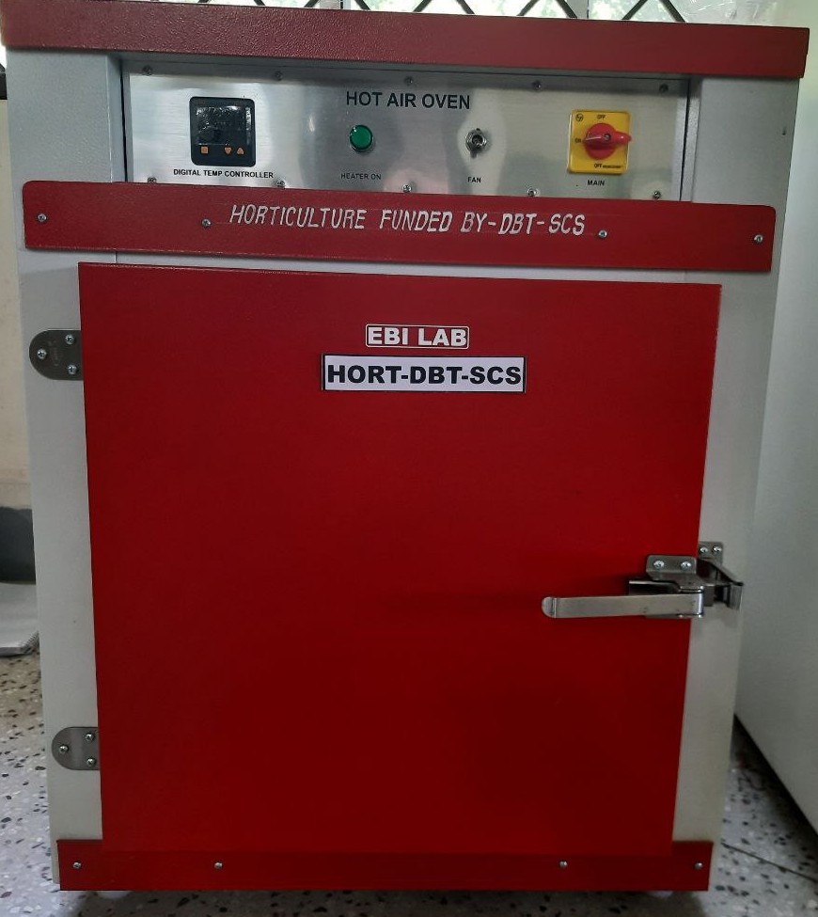
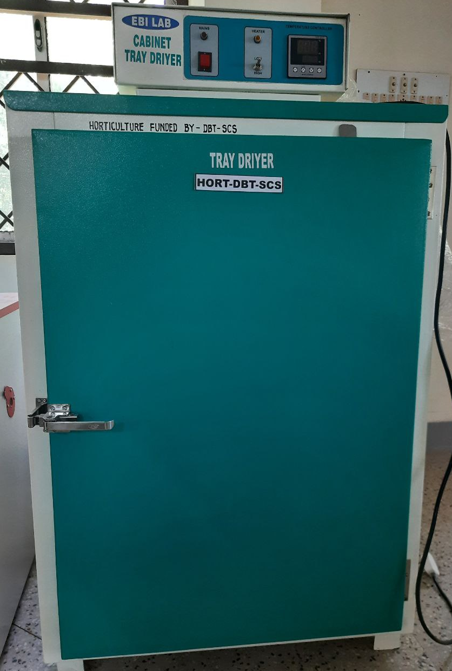
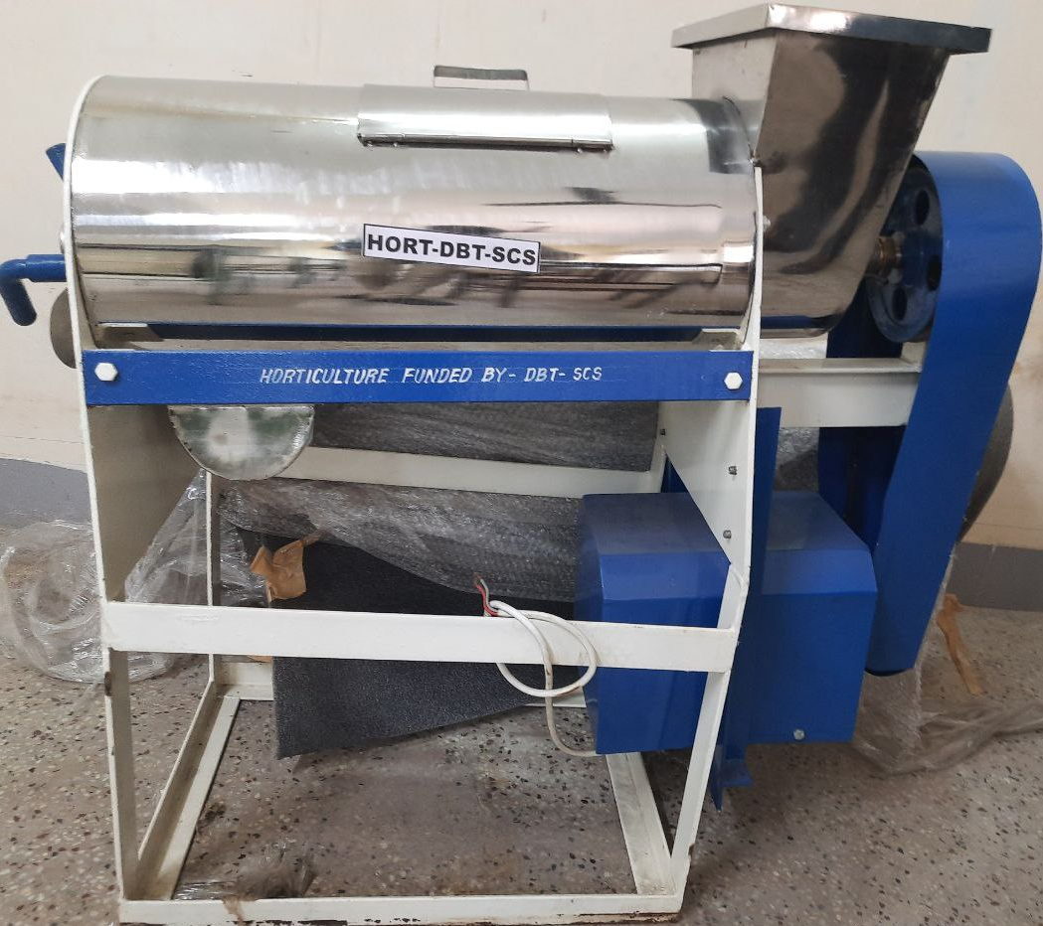
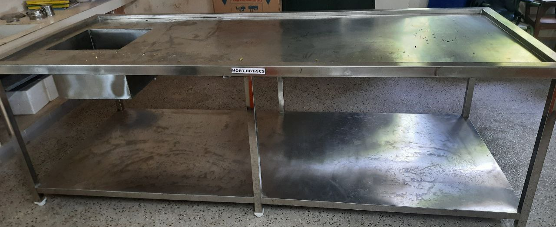
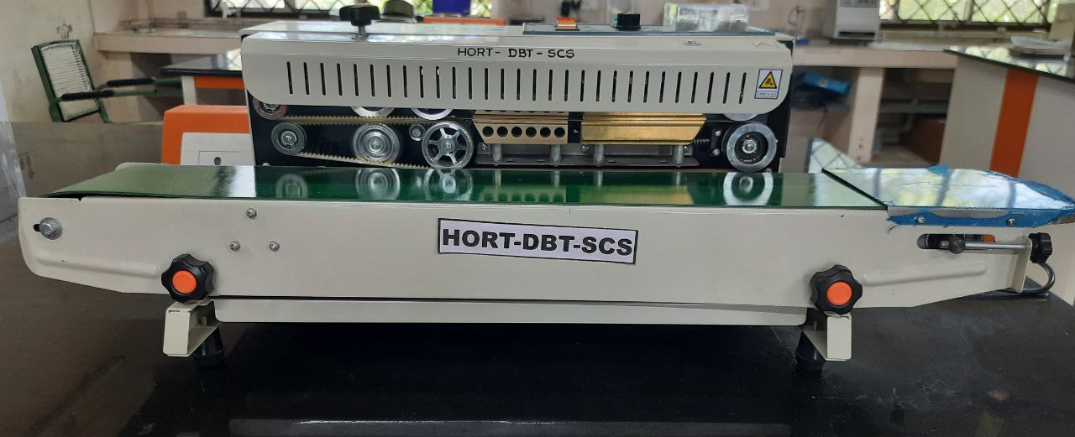
B. Equipment’s procured for proposed practical – non recurring CONTIGENCY
HOT AIR OVEN Rs.79,905/-
CABINET TRAY DRIER Rs.94,962/-
FRUIT PULPER Rs.87,360/-
WORK TABLE WITH STAINLESS STEEL TOP-Rs.99,710/-
CONTINUOUS BAND SEALING MACHINE – Rs.39,900/-

Slide 6
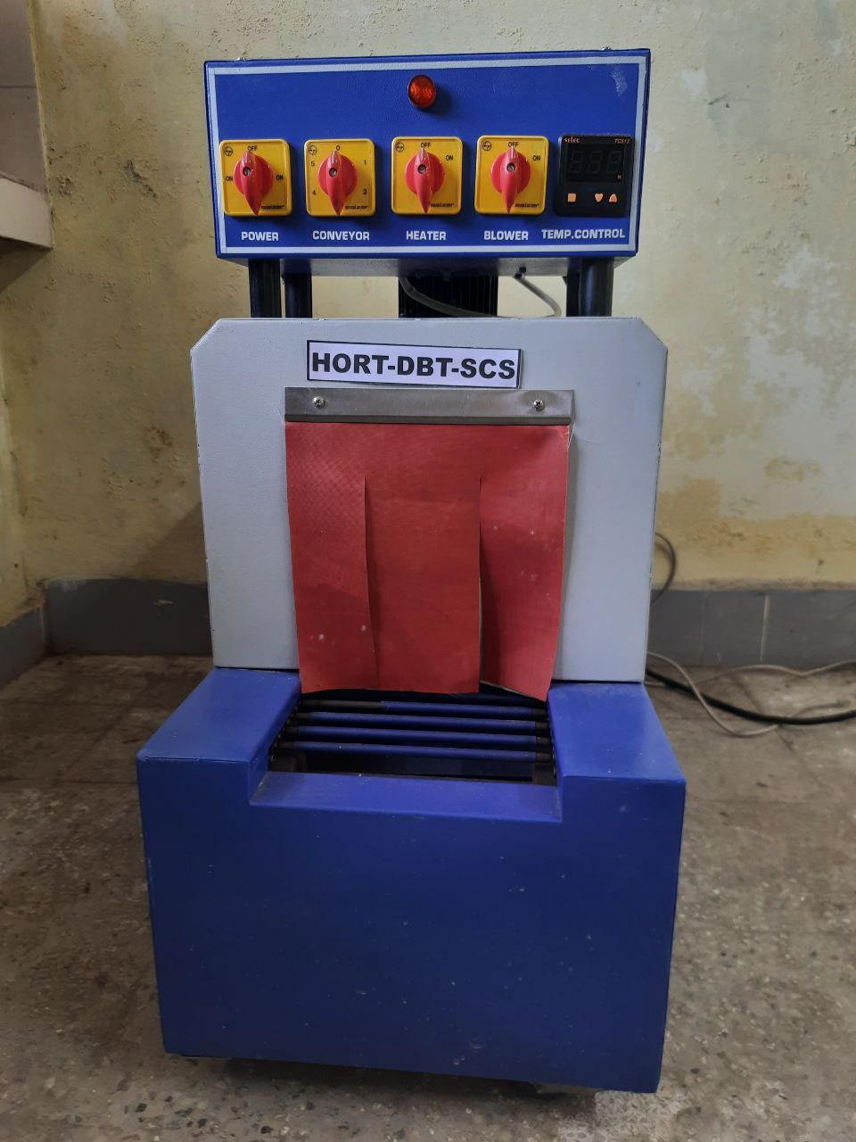
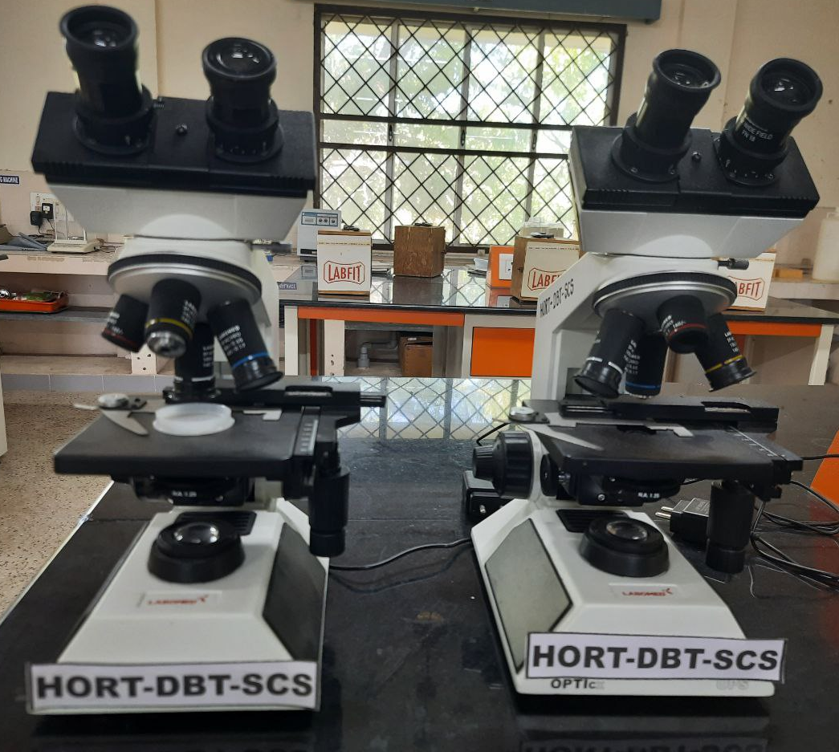
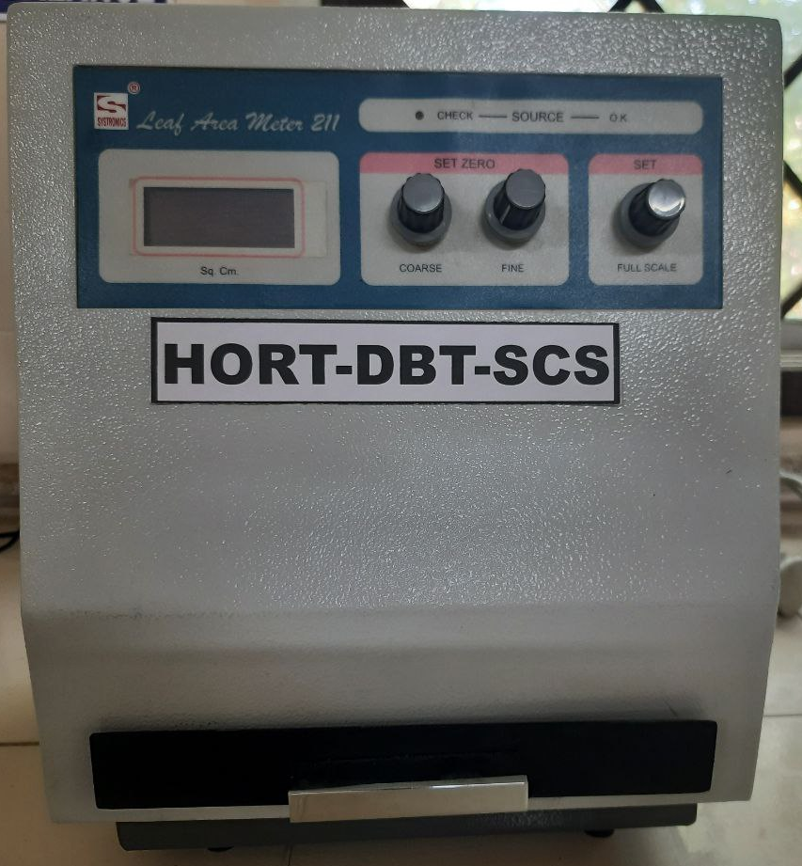
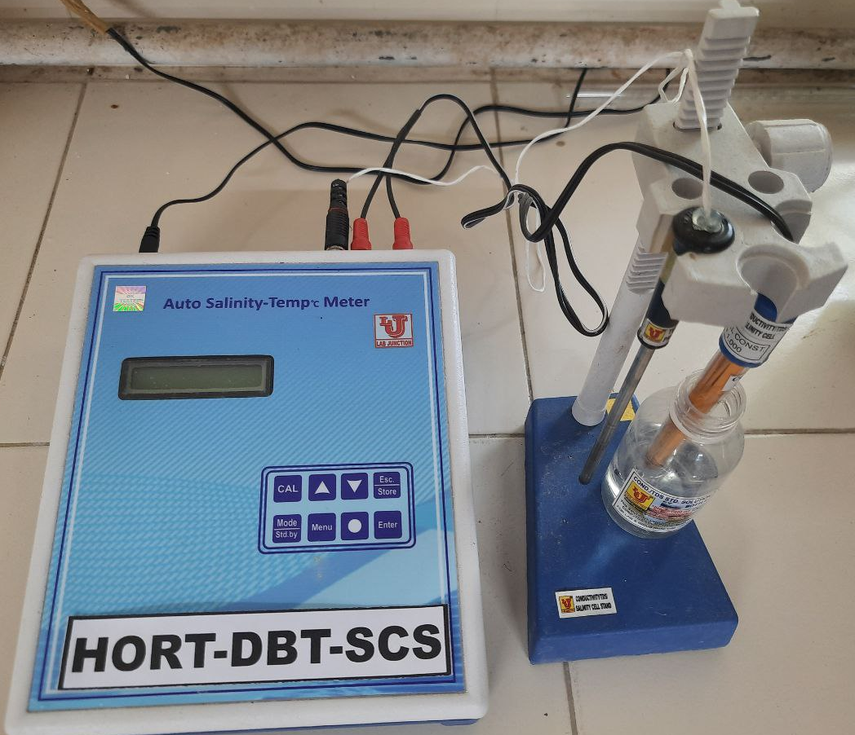
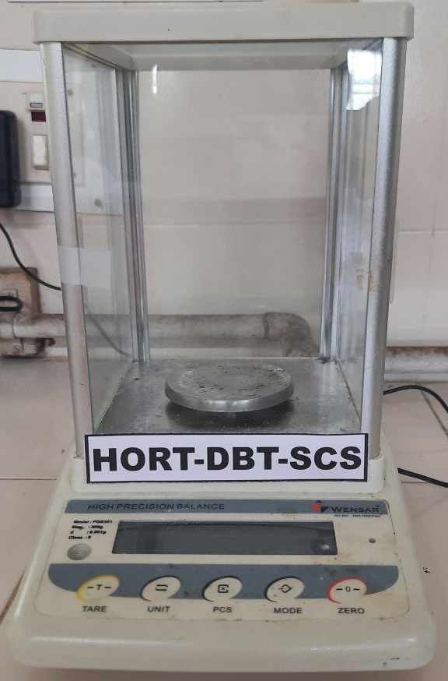
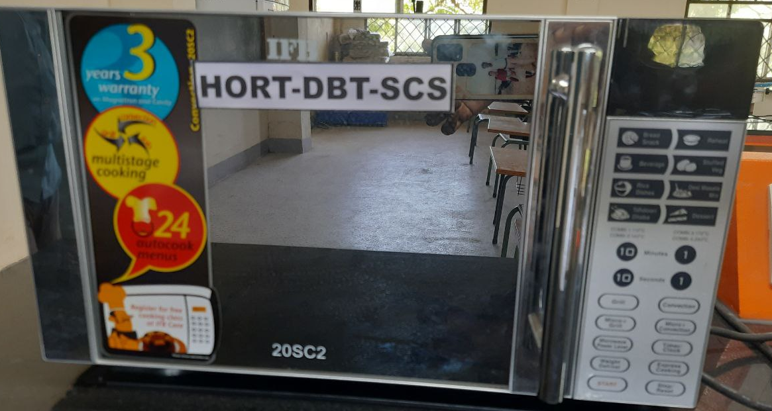
SHRINK WRAPPING MACHINE – Rs.74,970/-
COMPOUND MICROSCOPE –Rs.69,930/-
LEAF AREA METER-Rs.99,002/-
BRINE METER- Rs.14,910/-
WEIGHING BALANCE-Rs.59,850/-
MICROWAVE OVEN-Rs.16,905/-

Slide 7
A. New practical introduced in current curriculum
NAME OF THE COURSE | TITLE OF THE PRACTICAL
ELP 408 COMMERCIAL HORTICULTURE (0+10) | Standardization of rooting in cuttings of guava, Acalypha wilkisiana and ficus panda

Slide 8
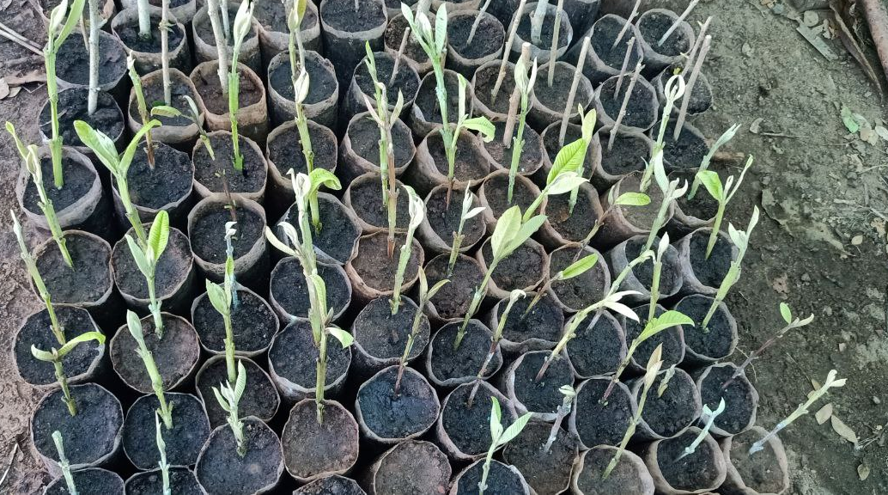
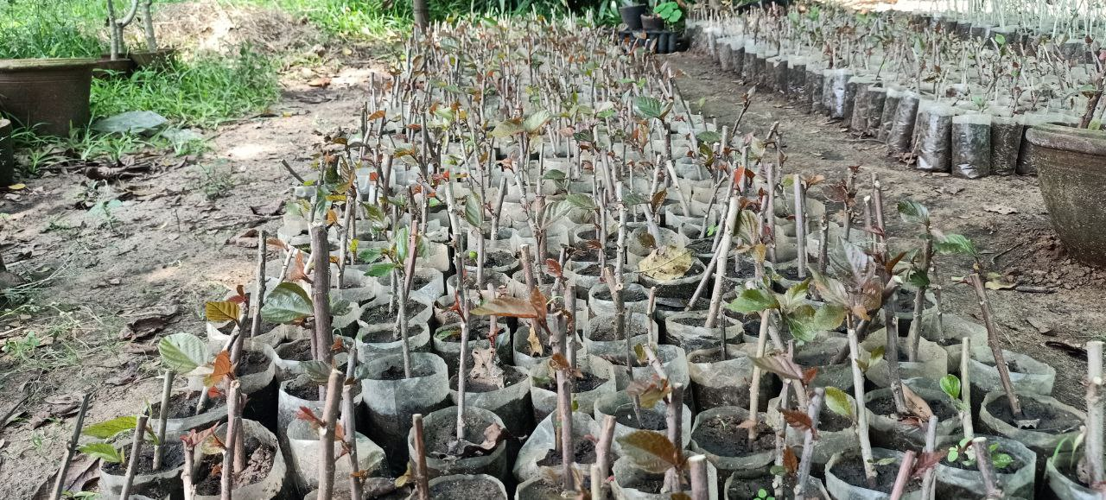
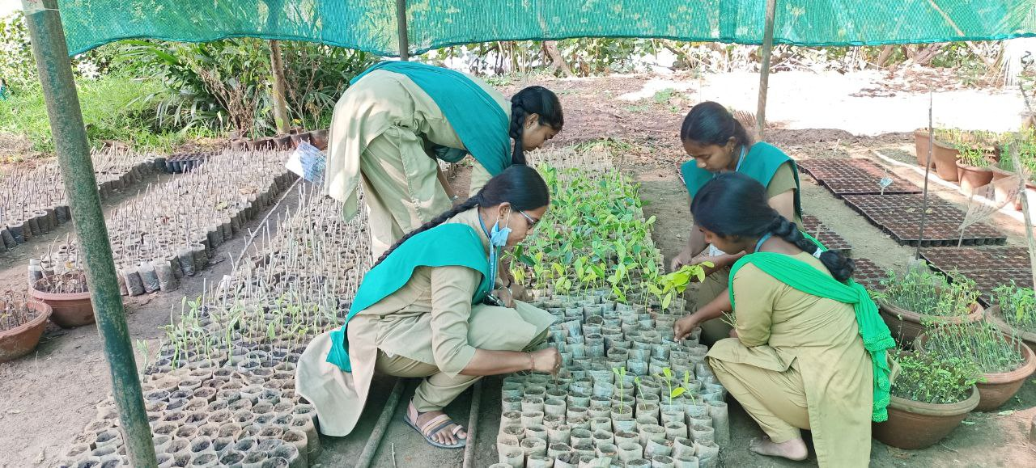
Standardization of rooting in cuttings
Guava – semi hardwood cutting + IBA 1000 ppm
Acalypha wilkisiana – hardwood cutting + IBA 1000 ppm
Ficus panda – Herbaceous cutting + IBA 500 ppm

Slide 9
a. . New practical PLANNED TO be introduced in current curriculum
NAME OF THE COURSE | TITLE OF THE PRACTICAL
PHT 201 Fundamentals of food technology (1+1) | Preparation of jam, jelly, marmalads and fruit beverages (RTS, Nectar, cordial & fruit syrub) – Fruit pulper Preparation of banana based baby food (powder) – Cabinet tray dryer Dehydration and osmotic dehydration of fruits (sapota, mango, banana, jack, karonda, aonla) and vegetables (moringa, brinjal, tomato, green chilli and beans) - cabinet tray dryer To conduct the storage studies on fruits and vegetables and their products – Deep freezer. To measure the internal pressure in canned processed food – Pressure tester To conduct packaging experiments in fruits and vegetables - shrink wrapping machine Preparation of tomato juice (RTS, Sauce) – Tomato juice extractor Sealing of beverage glass bottle - Crown corking machine
2. PHT 302 Post harvest management of horticultural crops (2+1) | 1. Different packaging methods for fruits and vegetable -
3. PHT 303 Processing of horticultural crops (1+2) 4. FSN 301Pricnciples of food science and nutrition (2+0) | Preparation of jam, jelly, marmalads and fruit beverages (RTS, Nectar, cordial & fruit syrub) – Fruit pulper Preparation of banana based baby food (powder) – Cabinet tray dryer Dehydration and osmotic dehydration of fruits (sapota, mango, banana, jack, caronda, aonla) and vegetables (moringa, brinjal, tomato, green chilli, turkey berry, beans) - cabinet tray dryer To conduct the storage studies on fruits and vegetables and their products – Deep freezer. To measure the internal pressure in canned processed food – Pressure tester Used to seal the product in polybag in air tight - continuous band sealing machine Preparation of tomato juice (RTS, Sauce) – tomato juice extractor Sealing of beverage glass bottle by using crown corking machine
5. HOR 301Growth and development of horticultural crops (2+1) | To work out the leaf area index and photosynthetic efficiency in horticultural crops – Leaf area meter To measure the biometrical observations - Vernier caliper

Slide 10
SKILLs TRAINING RECEIVED by the students with the support of dbt-scs

Slide 11
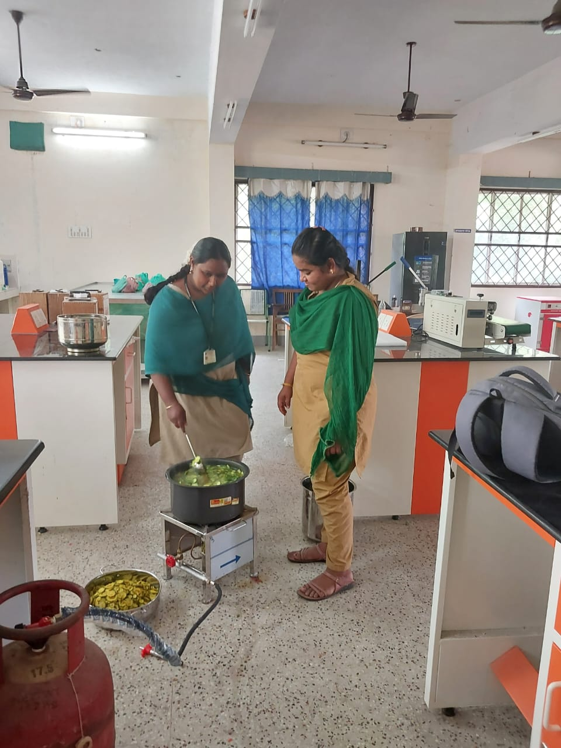
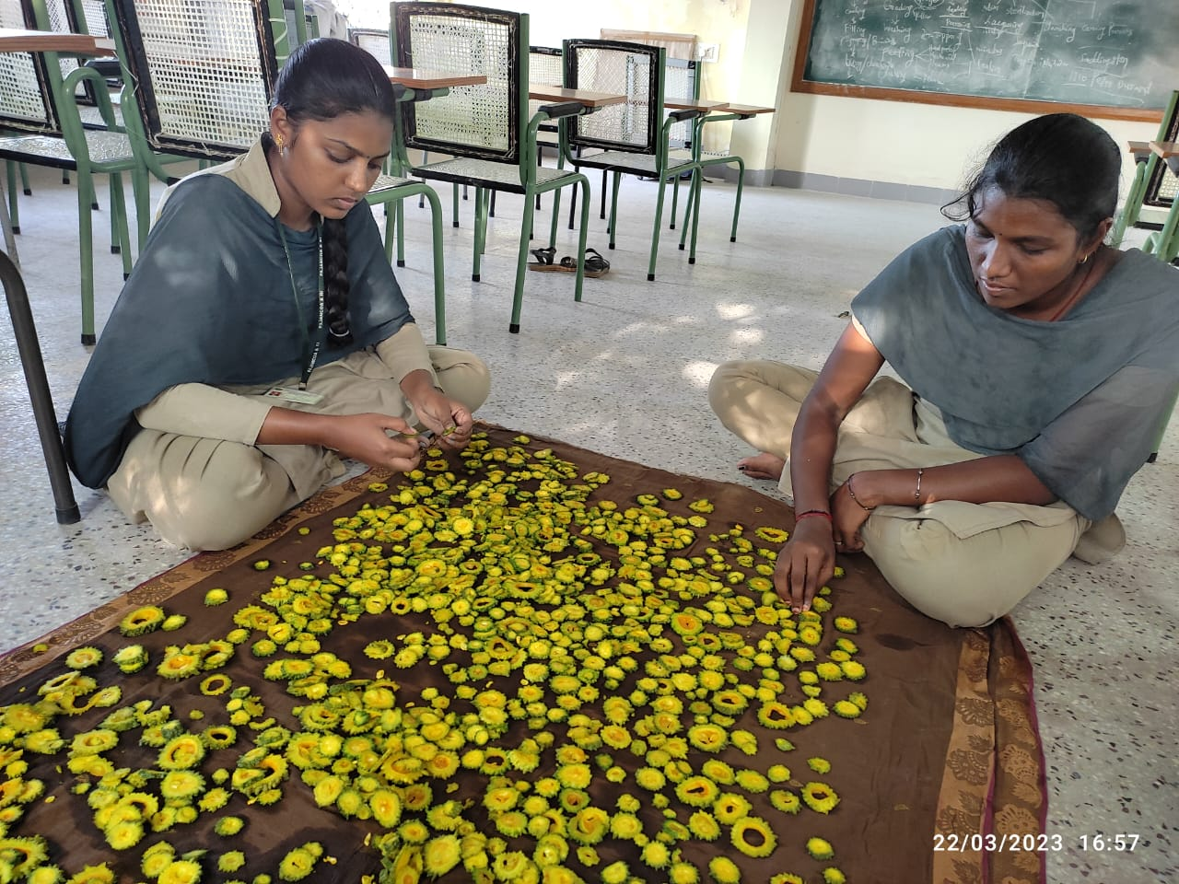
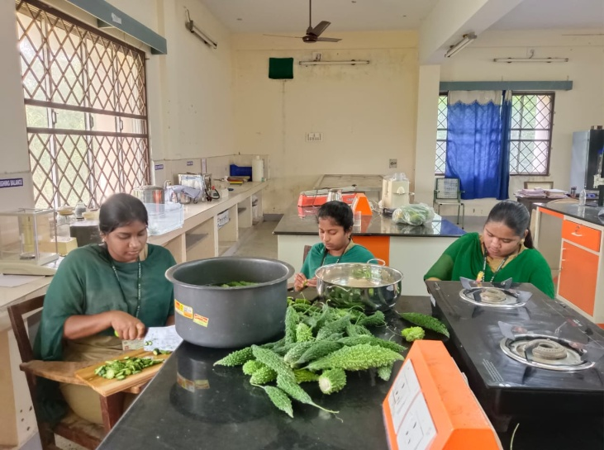
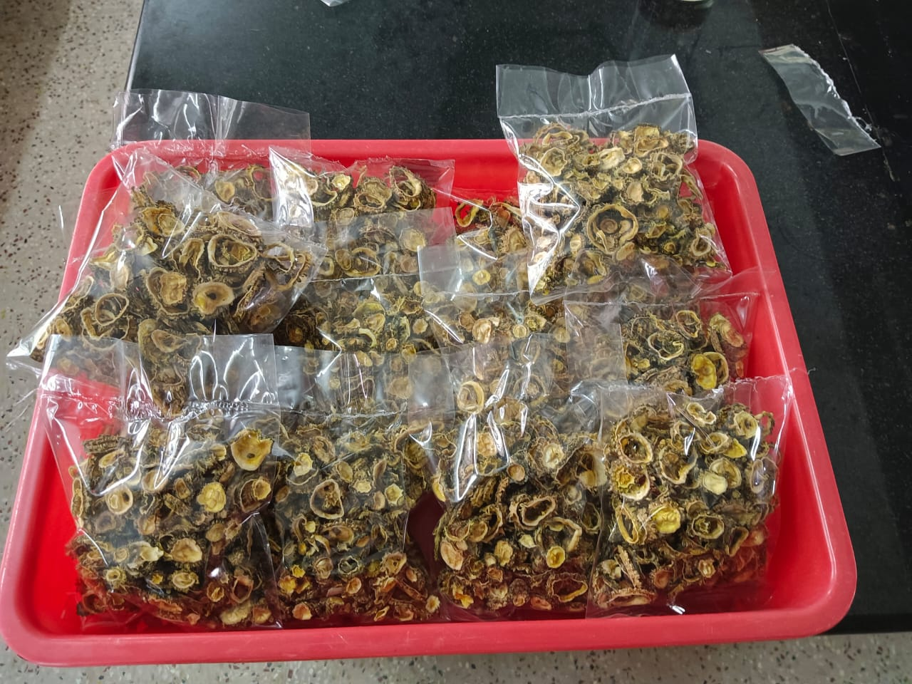
HANDS-ON TRAINING on PREPARATION OF DEHYDRATED BITTER GOURD

Slide 12
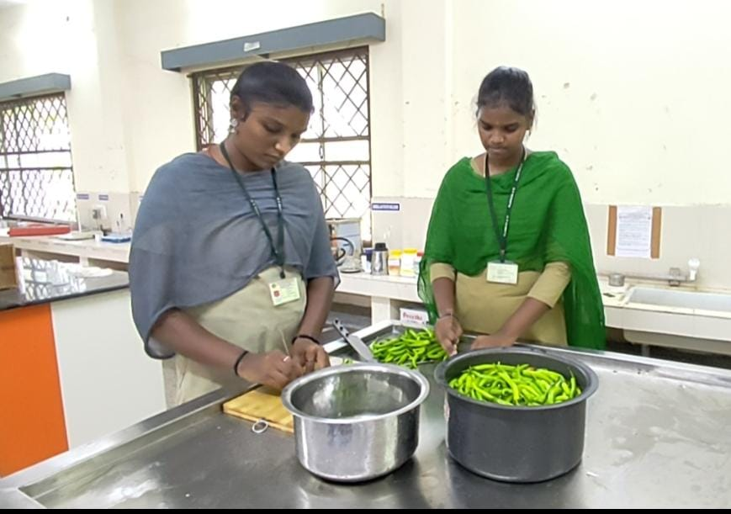
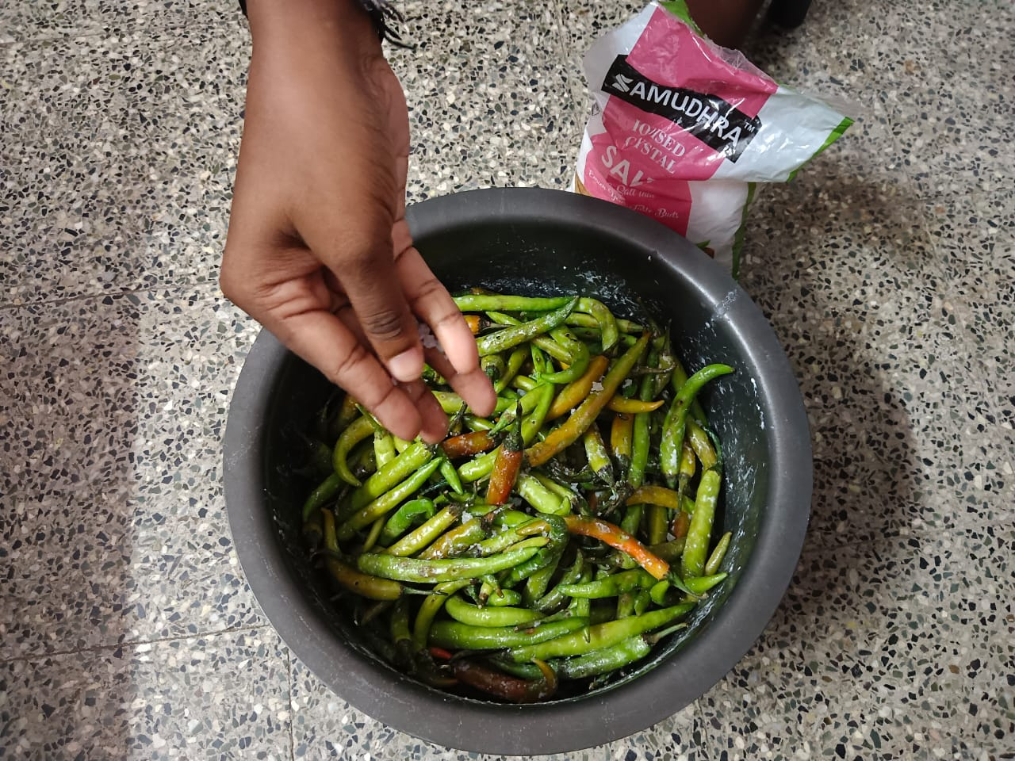
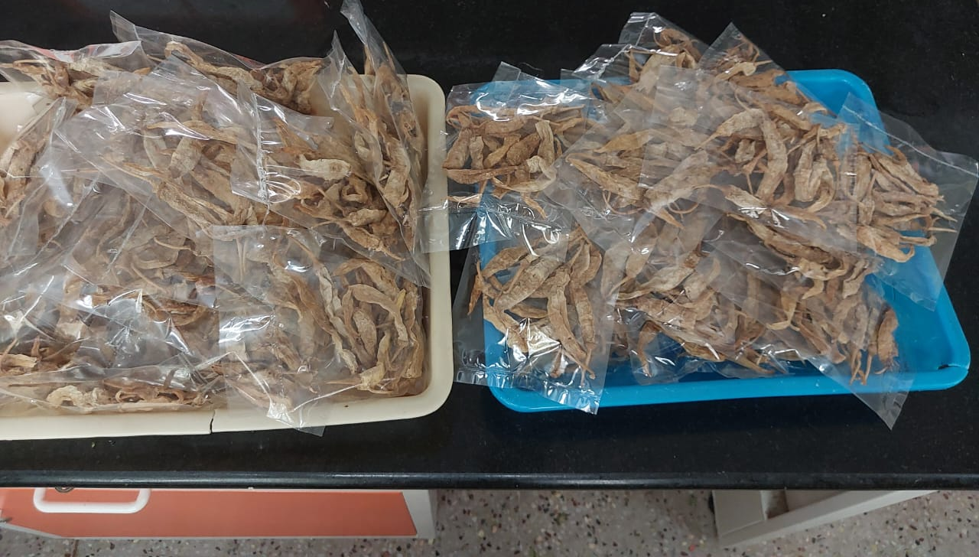
HANDS-ON TRAINING ABOUT PREPARATION OF DEHYDRATED CHILLI

Slide 13
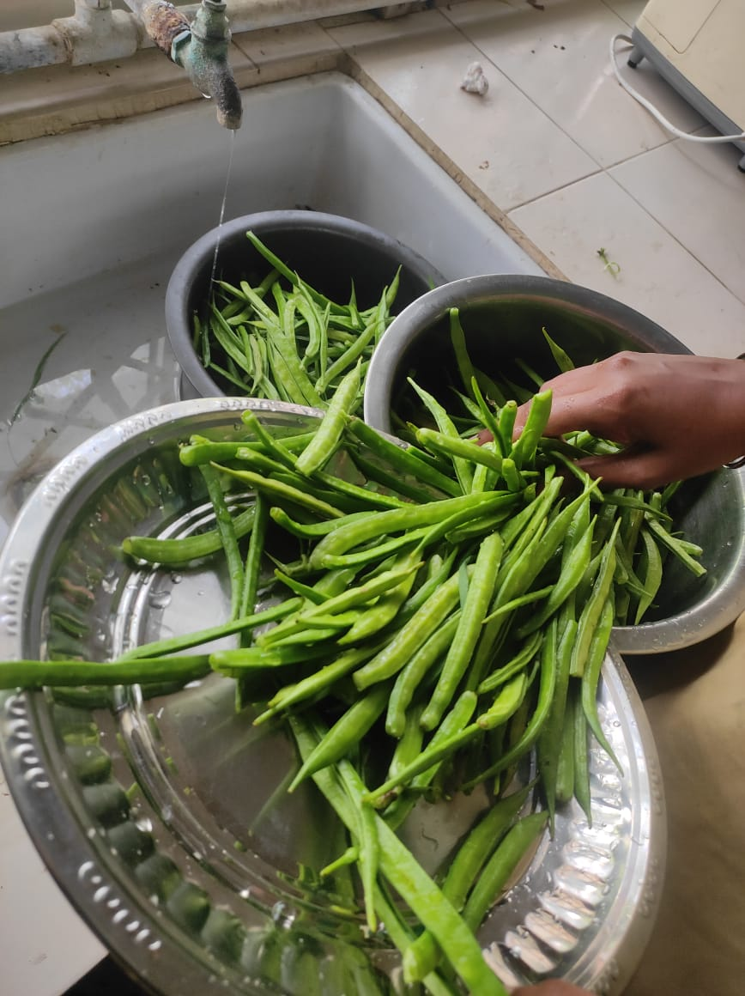
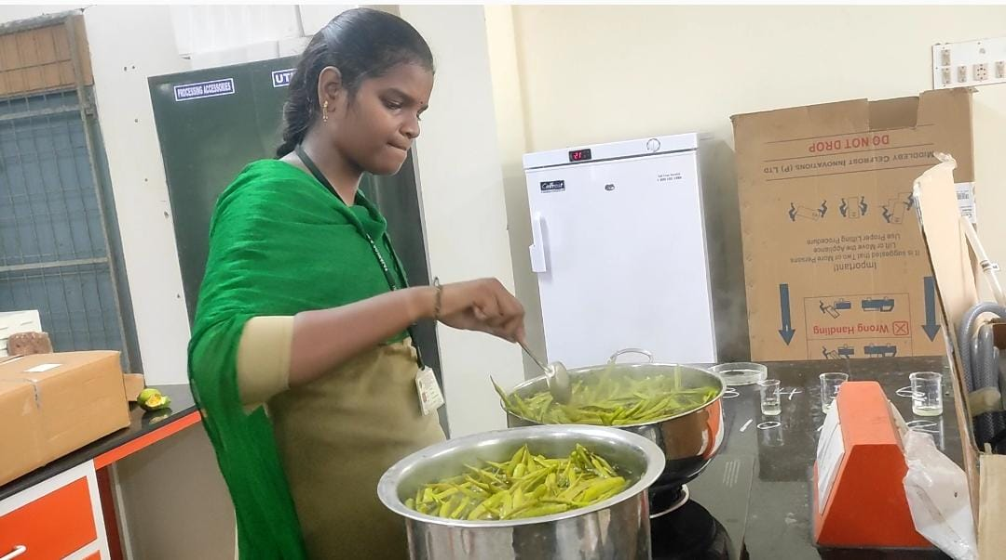
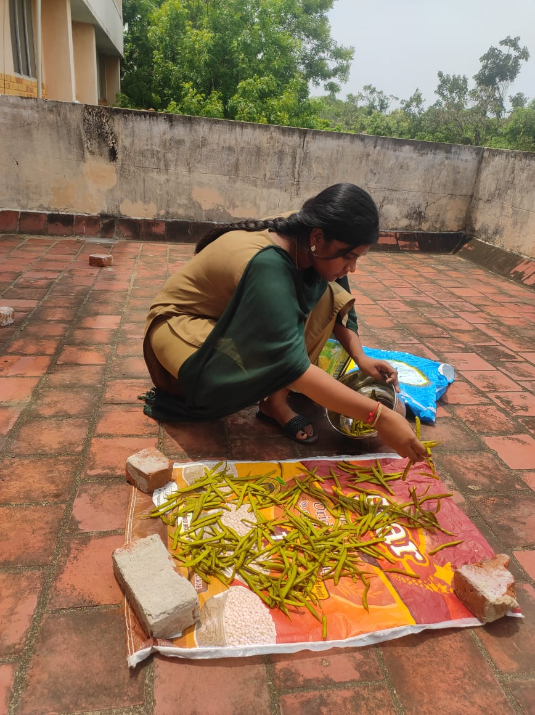
HANDS-ON TRAINING on PREPARATION OF DEHYDRATED cluster bean

Slide 14
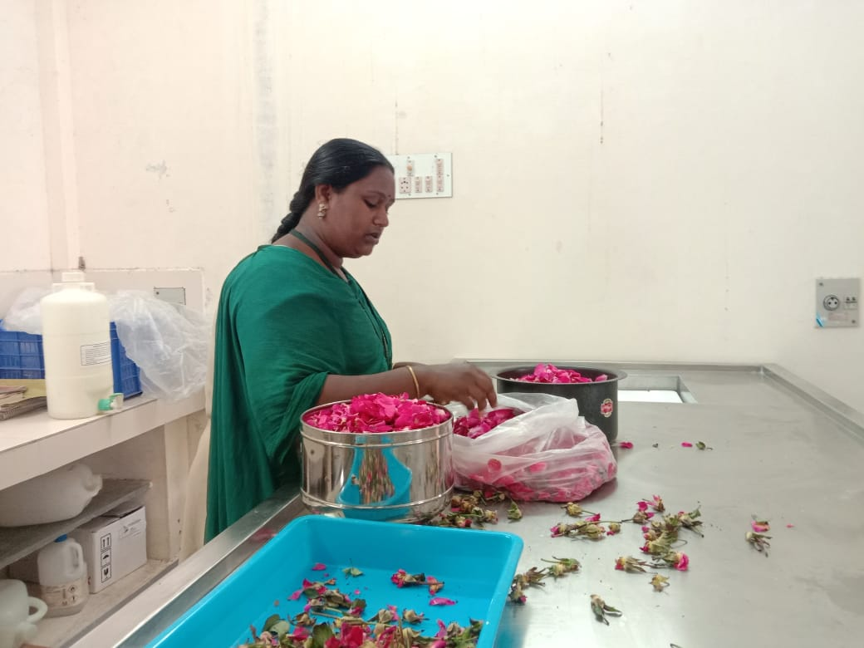
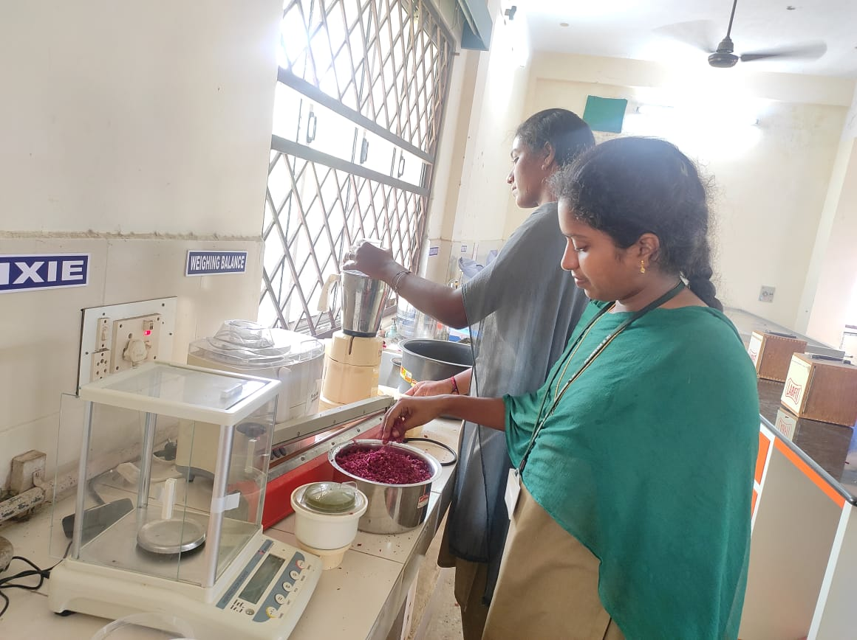
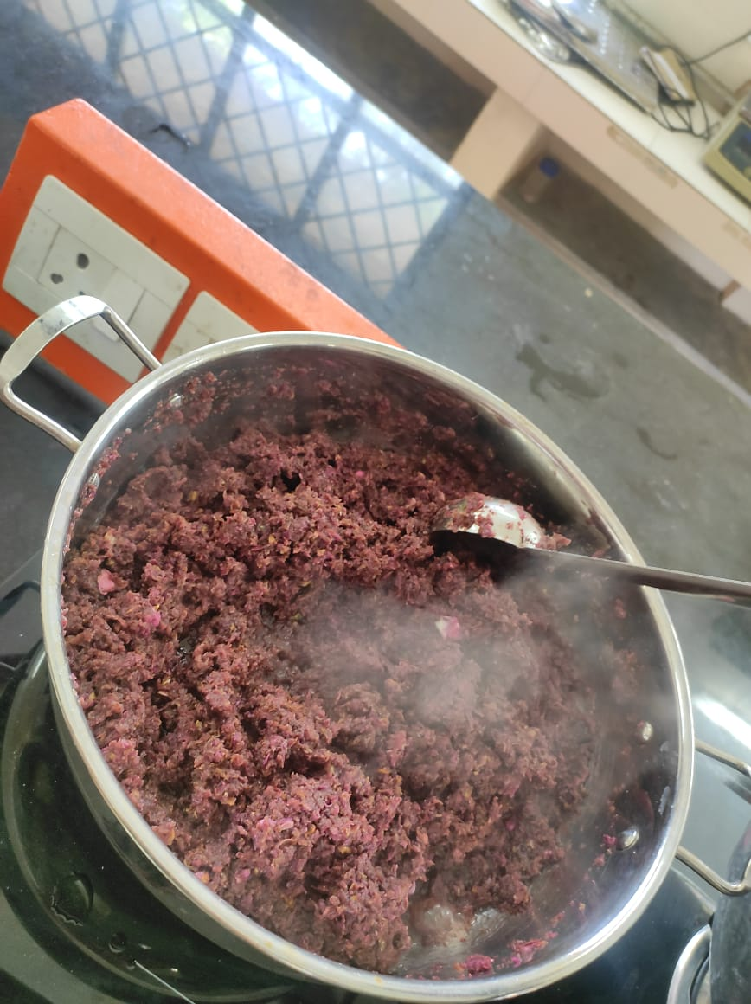
HANDS-ON TRAINING on PREPARATION OF rose GULKAND

Slide 15
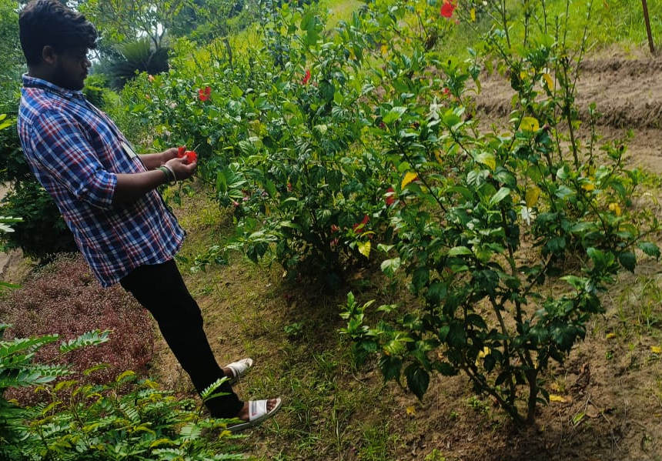
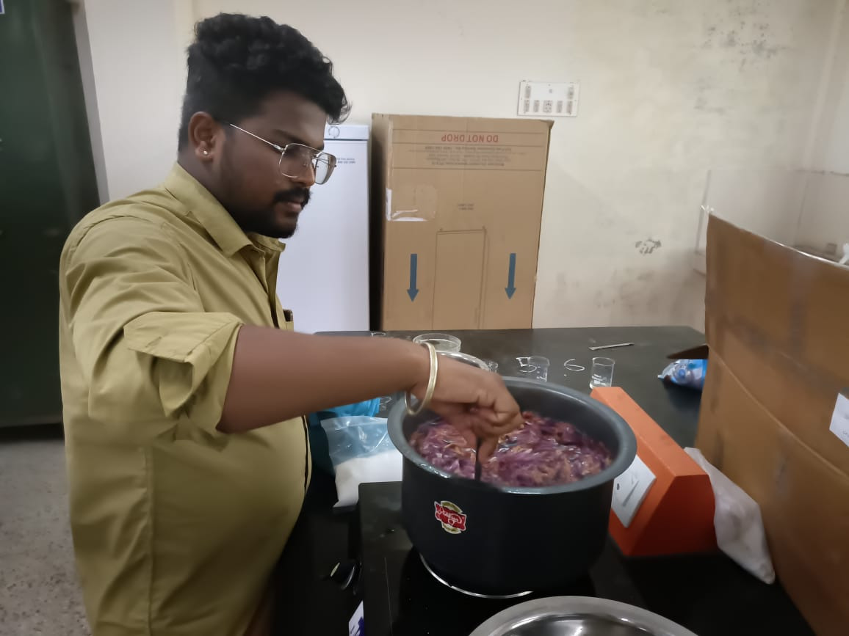
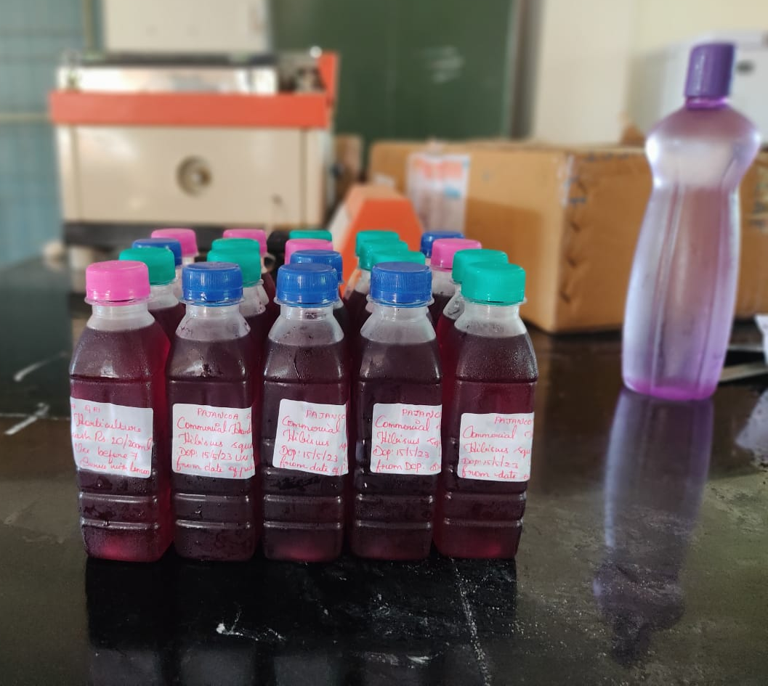
HANDS-ON TRAINING ABOUT PREPARATION OF HIBISCUS SQUASH

Slide 16
F. Visit to Industry and Important Labs

Slide 17
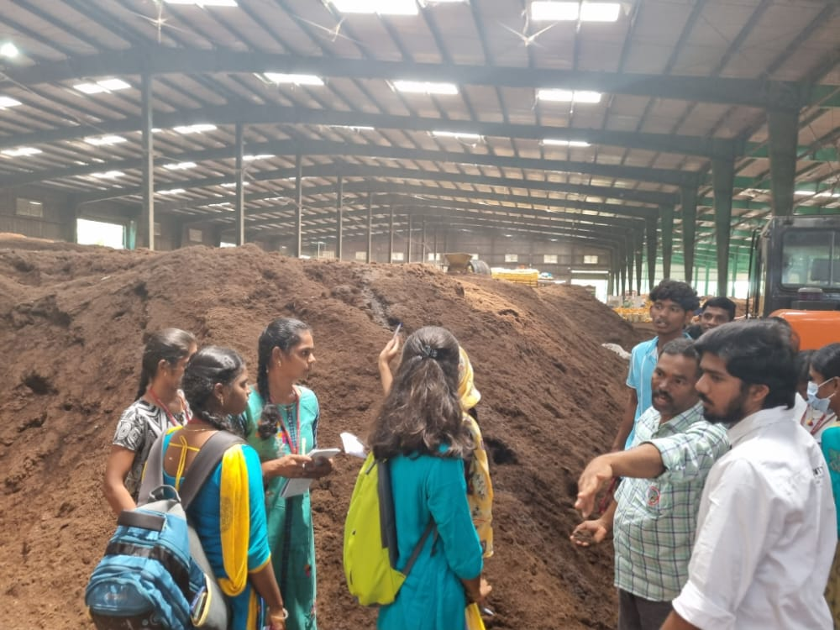
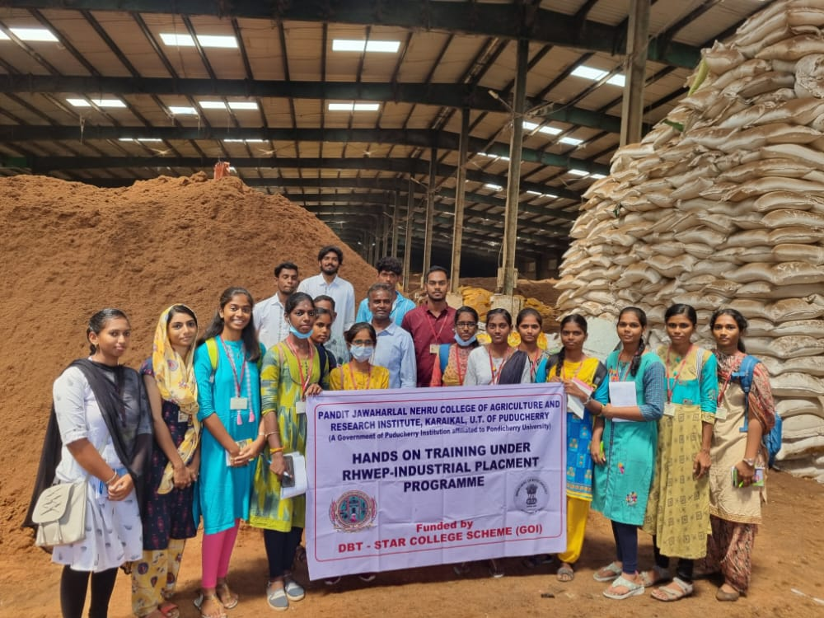
Annapoorna organic manure production unit, Karikalpalayam farm, Bengaluru

Slide 18
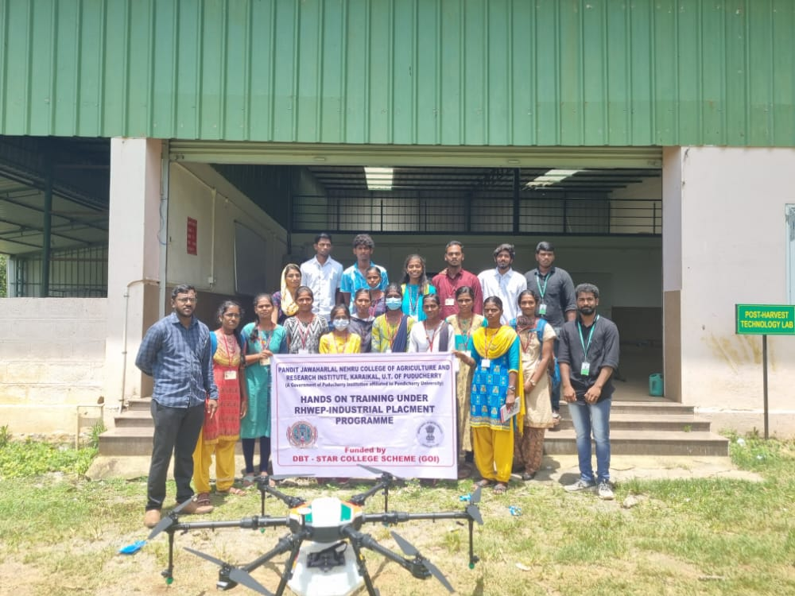
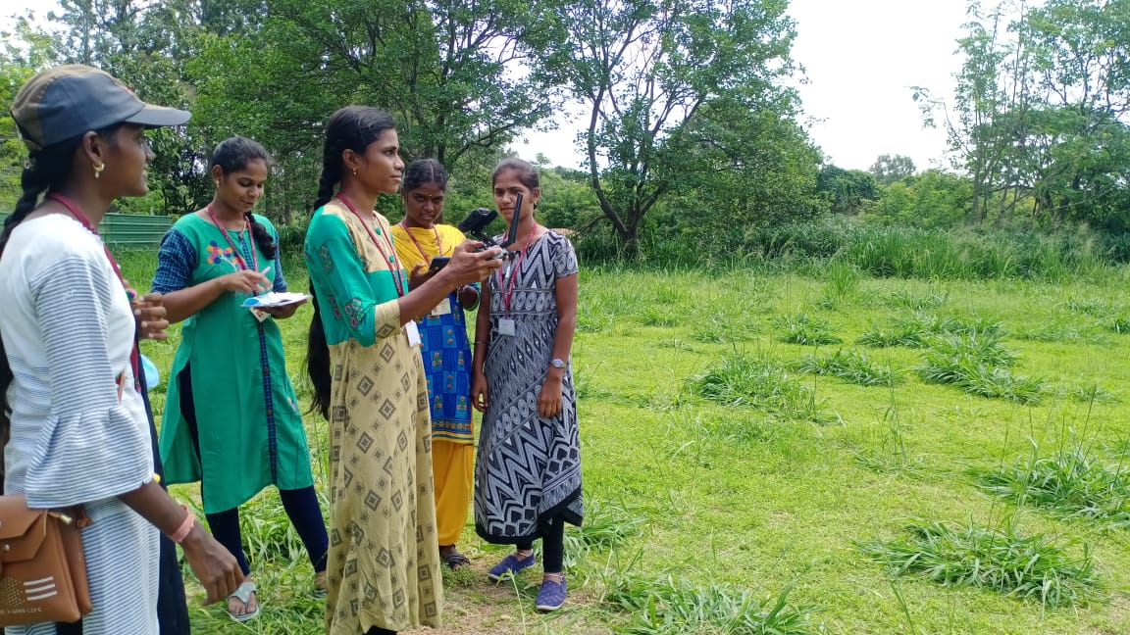
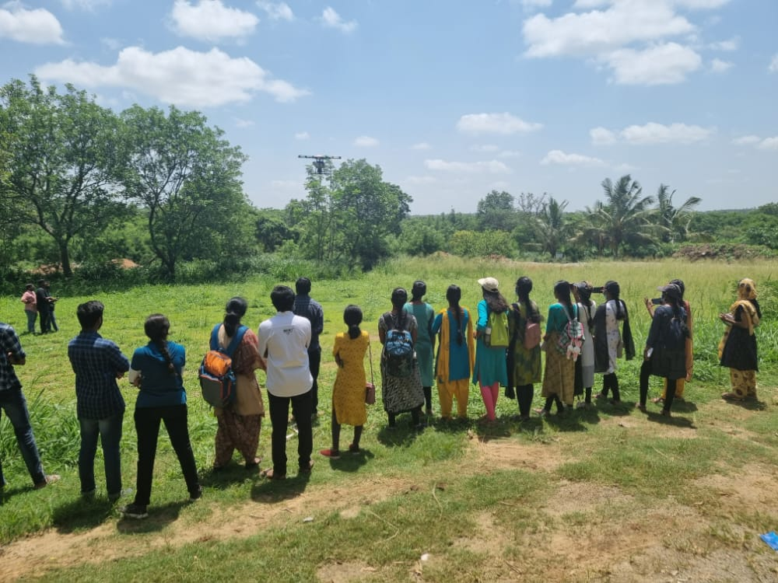
Multiplex Drones Pvt.Ltd., Vijaya Nagar, Bengaluru

Slide 19
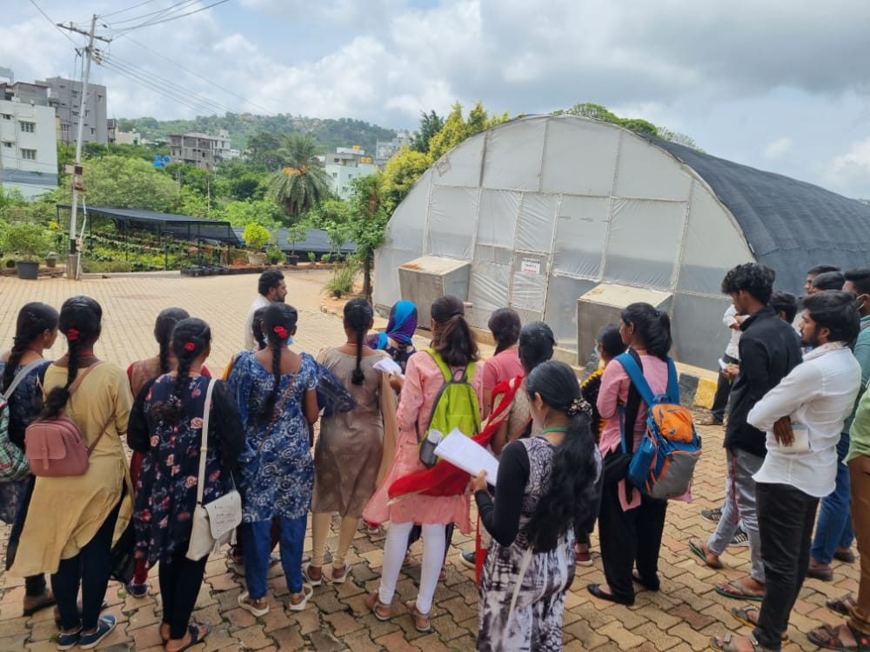
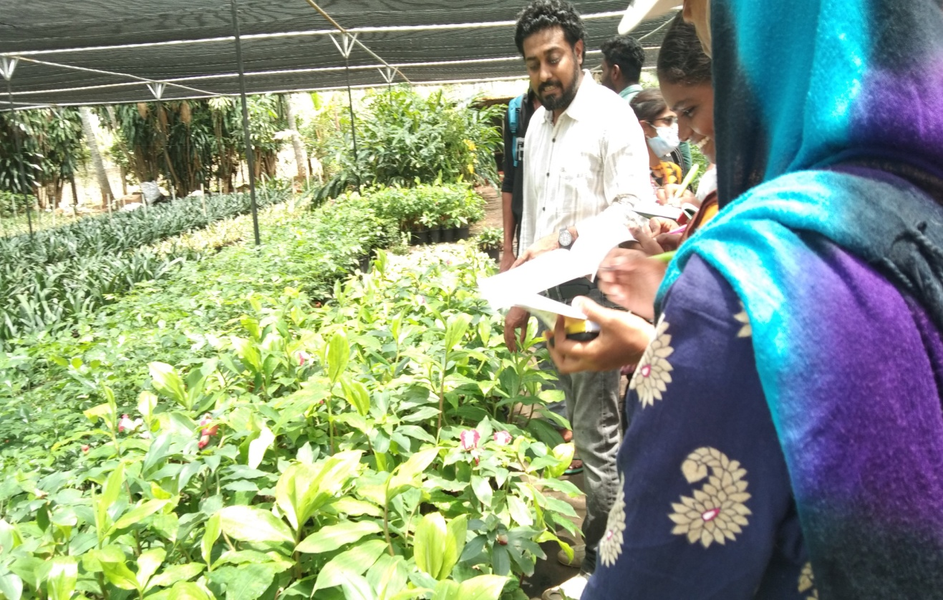
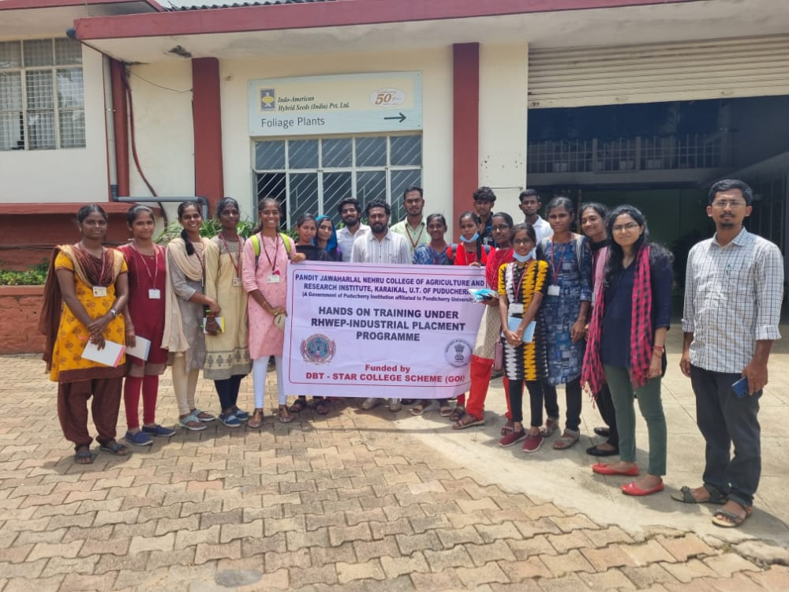
Indo American Hybrid Seeds Private Ltd, Bengaluru

Slide 20
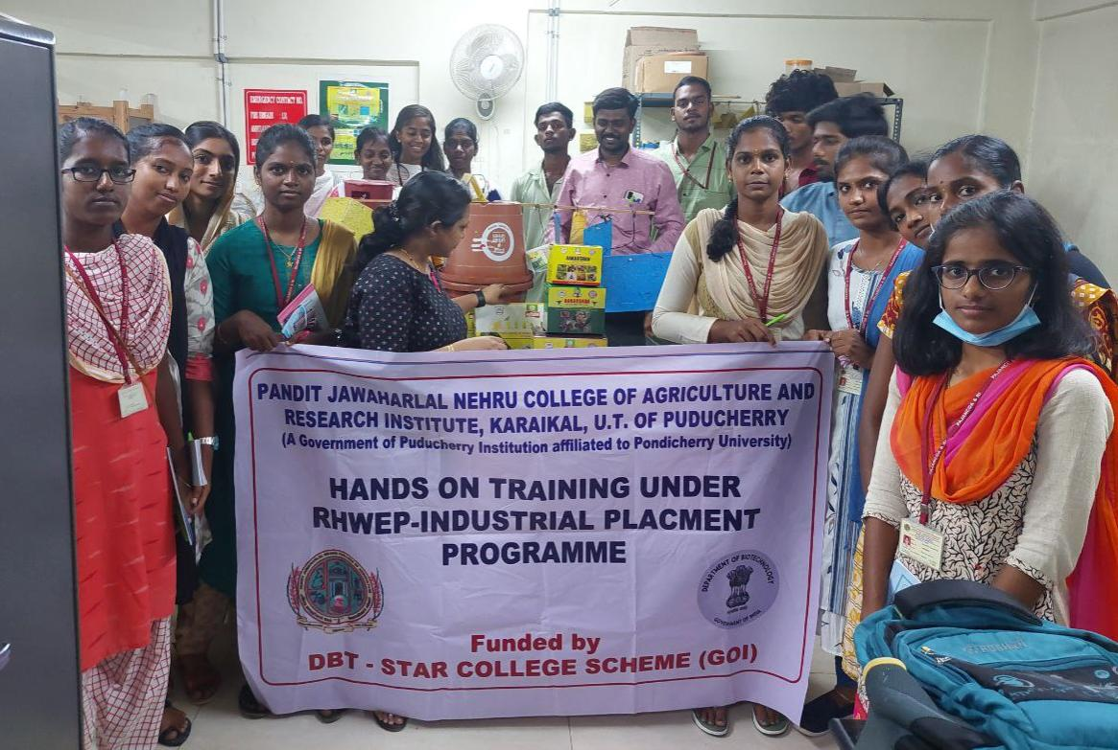
SEMIO-CHEMICAL LABORATORY OF GPS INSTITUTE OF AGRICULTURE & MANAGEMENT, PEENYA, BENGALURU

Slide 21
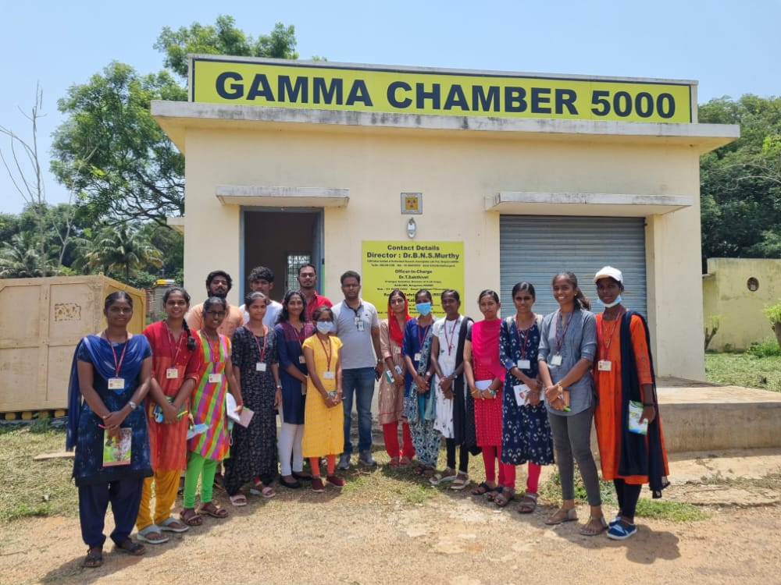
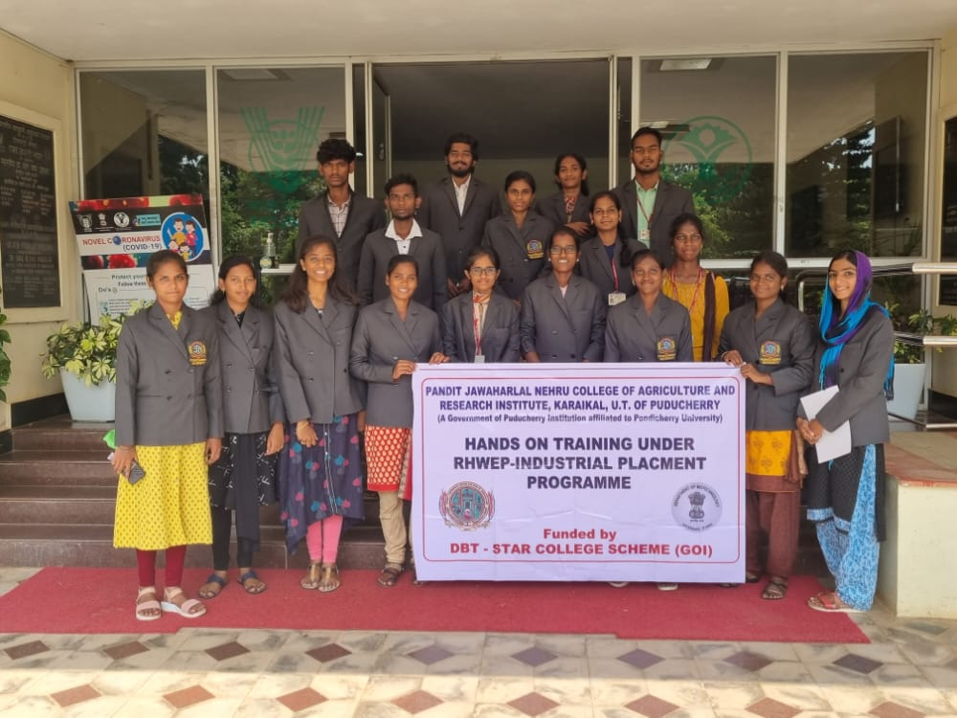
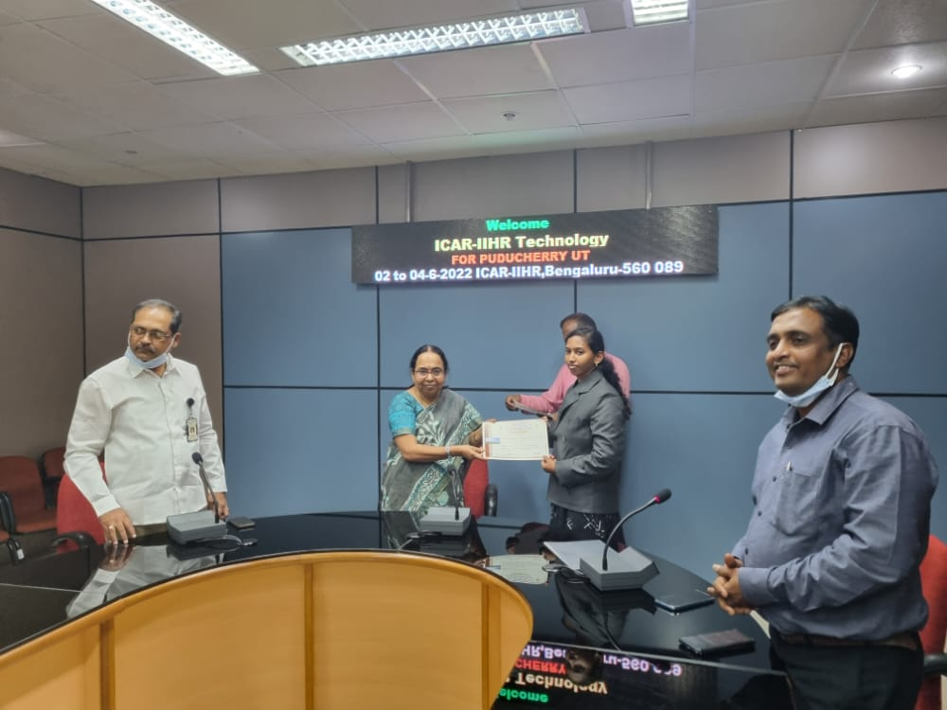
gamma rays chamber at IIHR, Bangalore

Slide 22
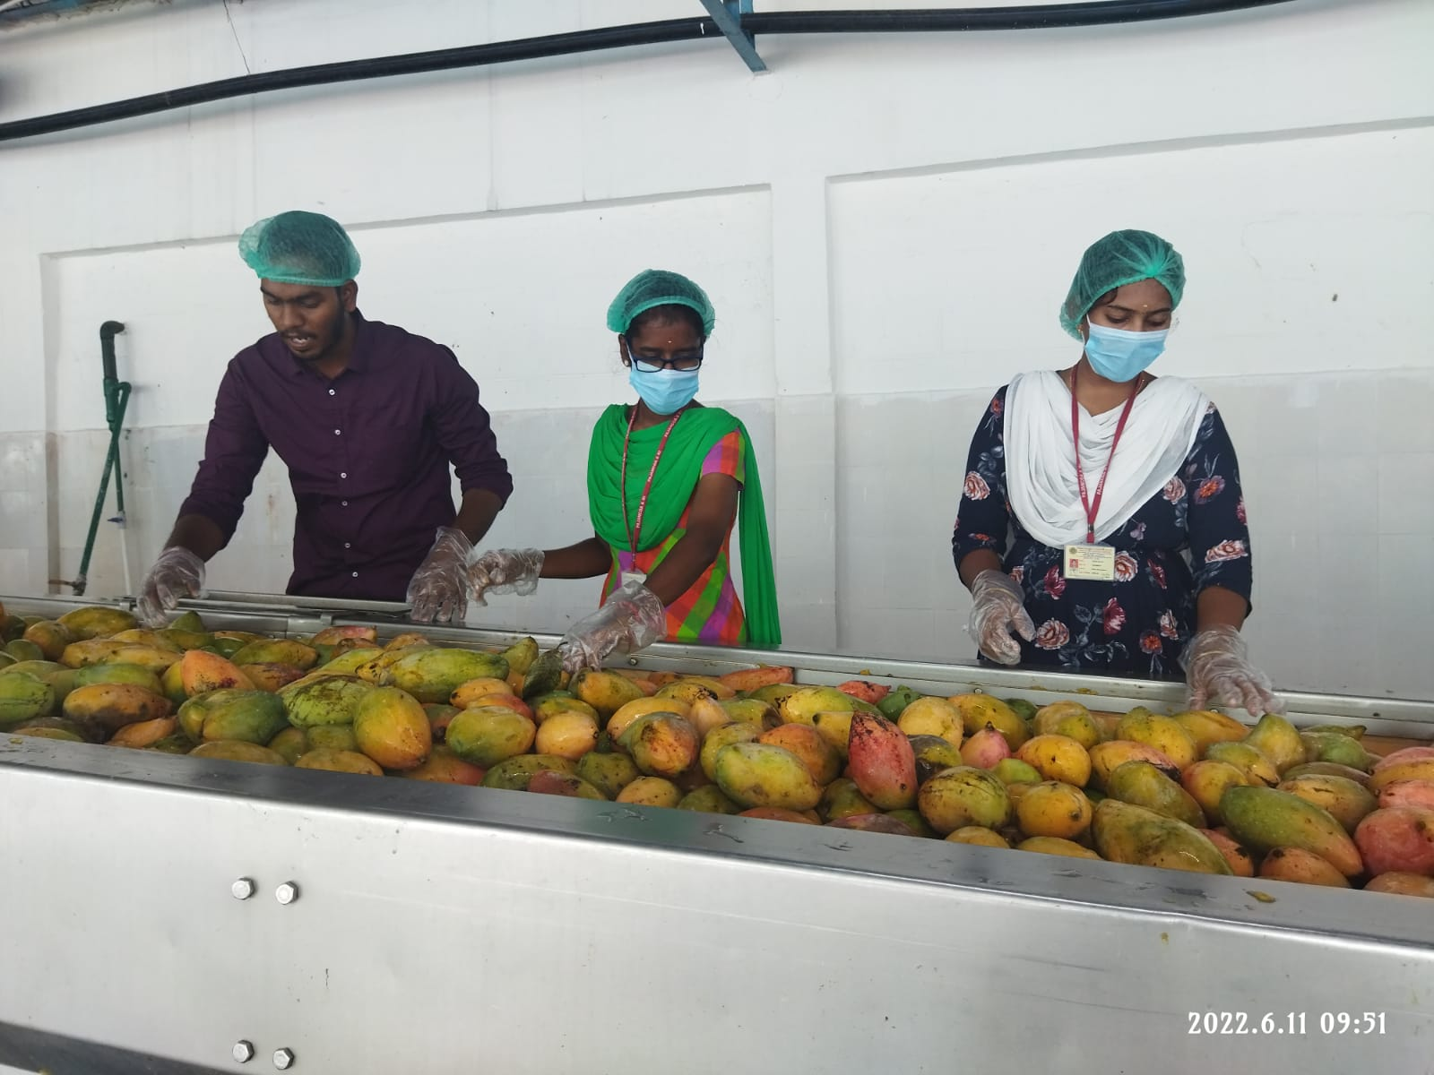
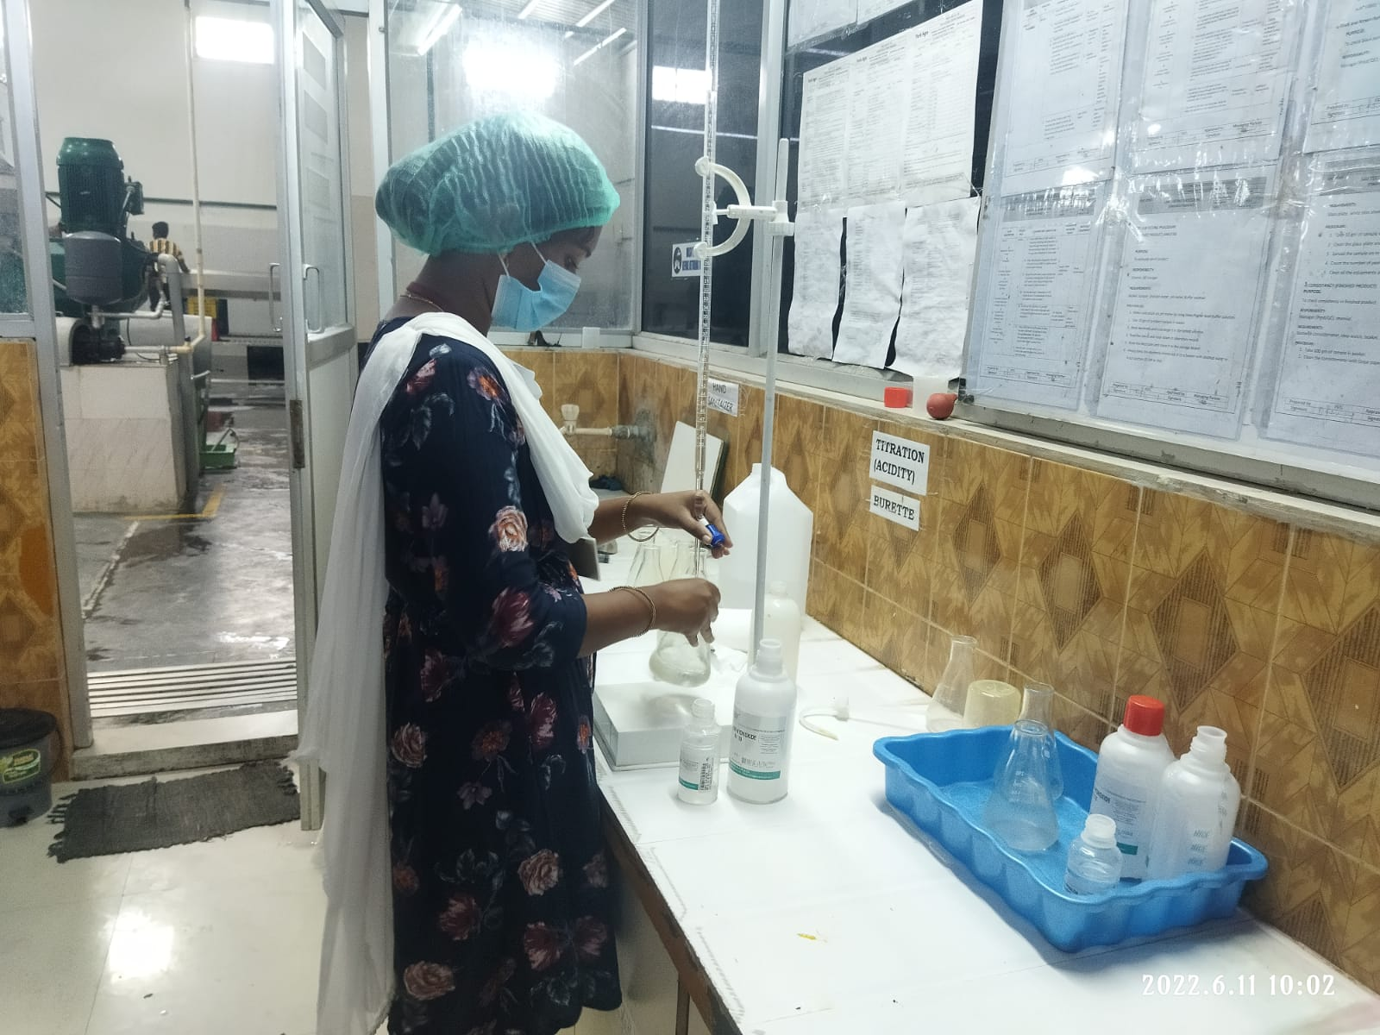
Pavithran mango pulping unit, Paiyur, Krishnagiri

Slide 23
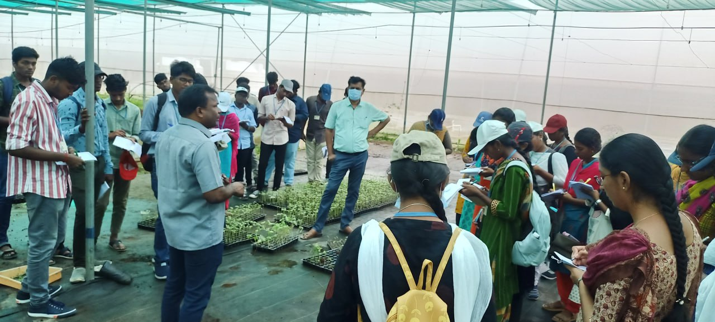
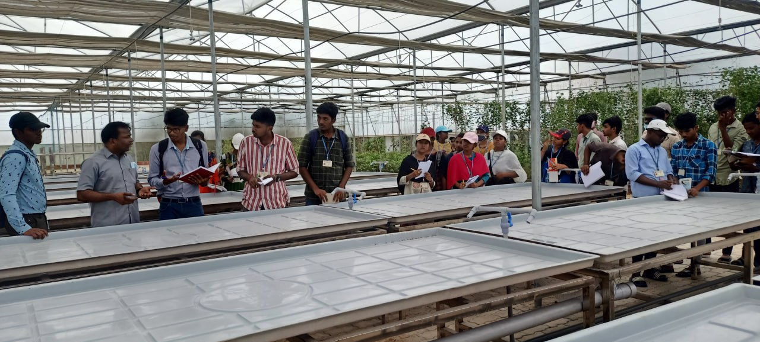
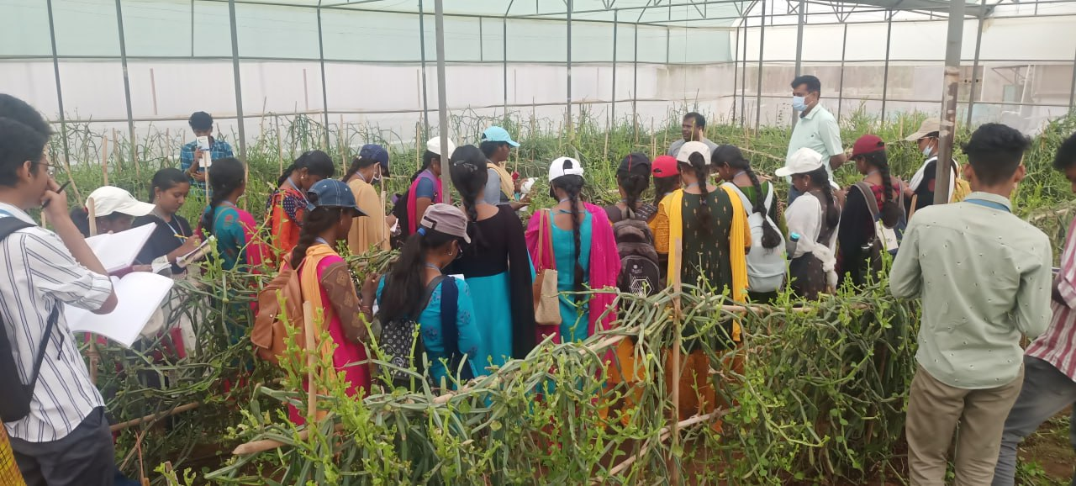
EXPOSURE VISIT- protected cultivation of Vegetable Crops

Slide 24
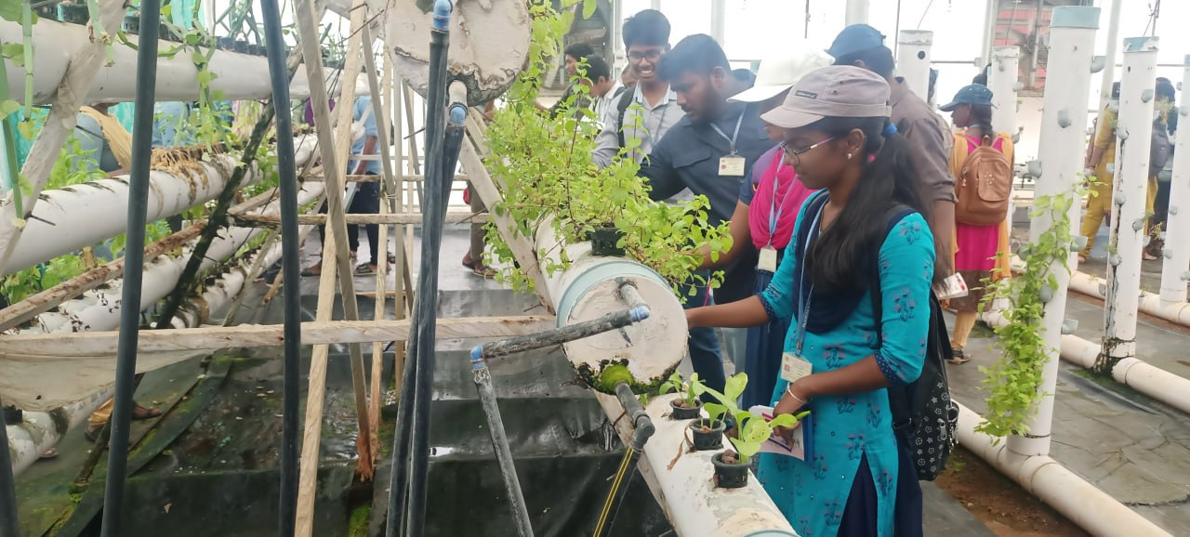
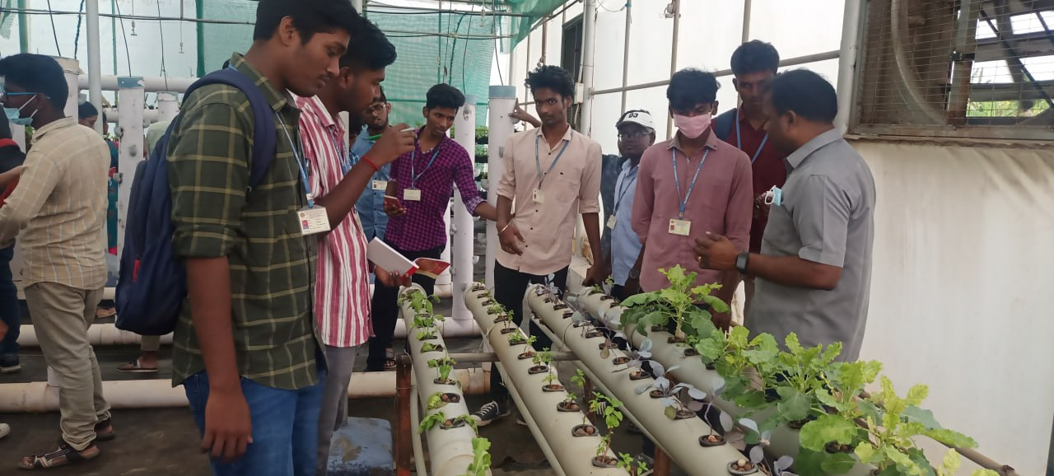
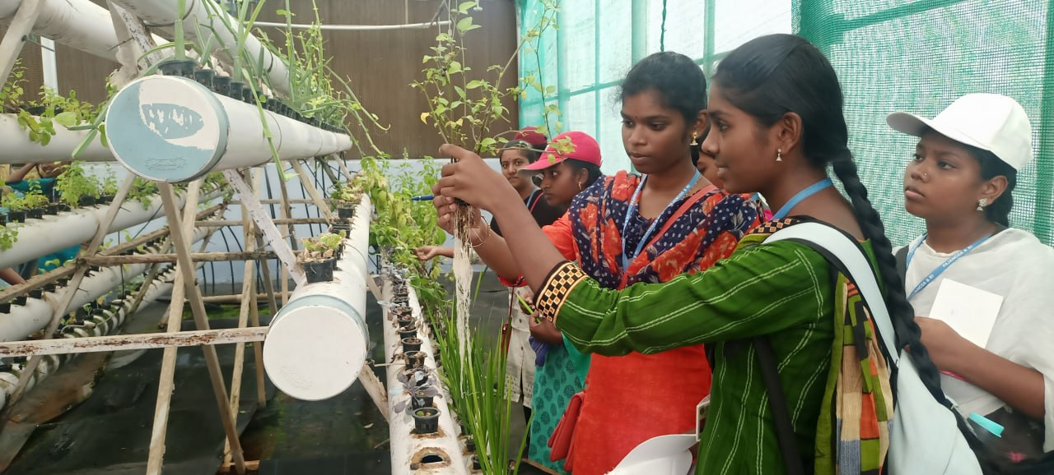
Practical exposure on vertical gardening

